Slide 1
Computational Photography Fall 2013 Final Project Proposal Topic: Non-Photorealistic Rendering App for NVIDIA Tablet
Akshay Joshi
Jacob Steele
Ritambhara Singh
Samyukta Jadhwani

Slide 2
Non-photorealistic rendering
Non-photorealistic rendering (NPR) is an area of computer graphics that focuses on enabling a wide variety of expressive styles for digital art.
In contrast to traditional computer graphics, which has focused on photorealism, NPR is inspired by artistic styles such as painting, drawing, technical illustration, and animated cartoons.
NPR has appeared in movies and video games in the form of "toon shading", as well as in scientific visualization, architectural illustration and experimental animation.
Source :Wikipedia

Slide 3
Styles
Cartoon (water color)
Pencil sketch
Painterly
Pointillism

Slide 4
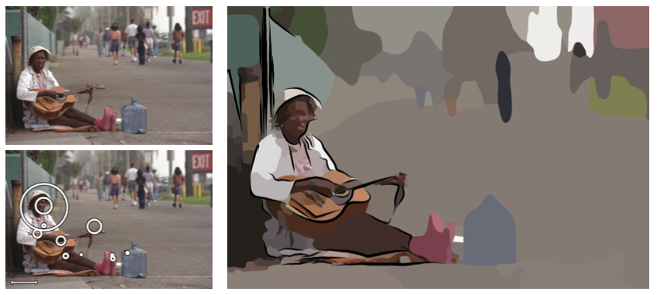
Cartoon (water color)
Source : Stylization and Abstraction of Photographs (DeCarlo et al)

Slide 5
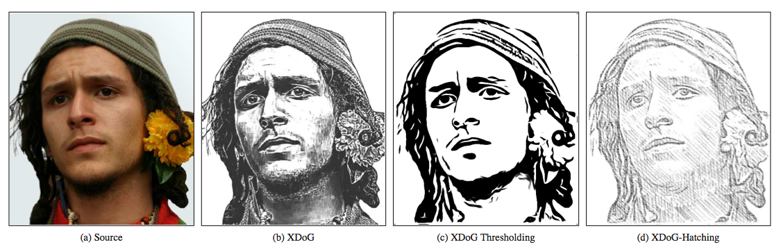
Pencil Sketch
Source :XDoG: An eXtended difference-of-Gaussians compendium including advanced image stylization (Holger Winnemöller et al)

Slide 6
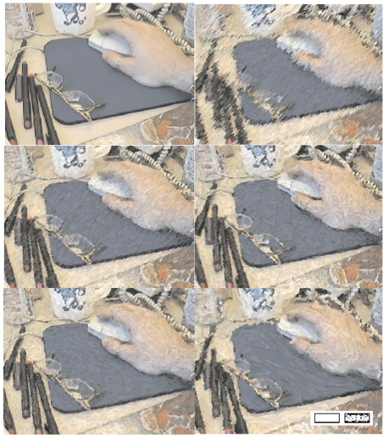
Painterly
Source: Non-Photorealistic Rendering (Anna Vilanova)

Slide 7
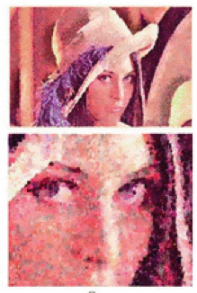
Pointillism
Source : Realization of Seurat’s pointillism via non-photorealistic rendering (Chuan-Kai Yung et al)

Slide 8
Plan of Action
Implement the discussed styles (1 style per member)
Develop an app for the tablet (Group effort)
The app transforms the given image into one of the four selected styles

Slide 9
Hurdles
App!!!!!!!!
We might not be able to integrate our program with the NVIDIA tablet
Back up plan: Develop more styles

Slide 10
Thank you ☺

